Slide 1
Transaction Signing and Mobile Token Integration for Funds Transfer (UX Walkthrough)
Jun 2018

Slide 2
What is Transaction Signing?
Transaction Signing is a term used in internet banking that requires customers to digitally "sign" transactions in order to verify the authenticity and integrity of an online transaction that is deemed as high risk.
Examples of transactions which may be deemed as high risk include making a high-value funds transfer and changing of customer details online.
How it works:
Challenge Code: 10 digit challenge code, please refer to last slide for challenge code logic
Internet Banking Website
1
Client
4
Transaction Authorization Code (TAC)
3
Transaction Authorization Code (TAC)
2
Challenge Code
Mobile Token
Notes:
You will be requested to confirm the online transaction you are about to perform by entering a dynamic PIN. This dynamic PIN is generated when a customer inputs information specific to a transaction, such as an account number or a transaction amount, into a device. Why is it necessary to perform transaction signing? Transaction signing is an effective method used to detect interception and modification of your online transaction from malware or, viruses employing “man-in-the-middle” types of attack.

Slide 3
Benefits and Overview of Changes
Benefits
Prevents “man-in-the-middle" attacks by digitally securing transactions.
Industry standard adopted by financial institutions.
Effective method to replace first-time payee and independent call back thereby increasing productivity.
Enhances client experience by providing seamless integration with Mobile Token and reduction of call back by the bank.
Change Overview
Mobile Token integration with Funds Transfer.
Implement Transaction Signing for Add Payee and High-Value Funds Transfers, thereby eliminating the call-back associated with the respective high-risk transactions.

Slide 4
Prerequisites for Transaction Signing
Transaction-signing is mandatory for all high-risk transactions performed on mobile devices.
Mobile token has to be enabled in order to perform transaction signing. If user has not registered for mobile token, he/she will be redirected to register before proceeding with the high-risk transaction on mobile.
For non-mobile token registered clients performing high-risk transactions on IVC web, existing manual process (manual call back) will be followed.

Slide 5
Key Scenarios
Mobile Platform (IPad or IOS) – Android in October
Non-mobile token enabled user performing low-value funds transfer.
Non-mobile token enabled user performing high-value funds transfer or add payee.
Mobile token enabled user performing low-value funds transfer on the same device.
Mobile token enabled user performing high-value or add payee funds transfer on the same device.
Mobile token enabled user performing low-value funds transfer on a different device.
Mobile token enabled user performing high-value funds transfer or add payee funds transfer on a different device.
Web Platform – InView Client Web
Non-mobile token enabled user using FT.
Mobile token enabled user performing low-value funds transfer.
Mobile token enabled user performing high-value funds transfer or add payee.

Slide 6
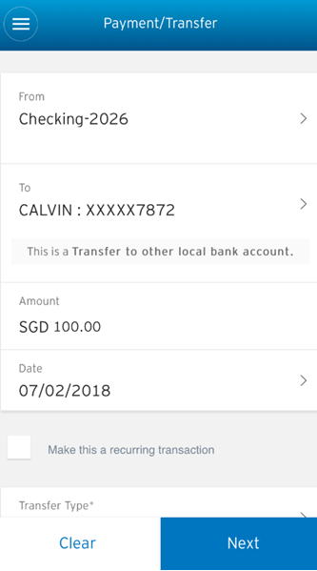
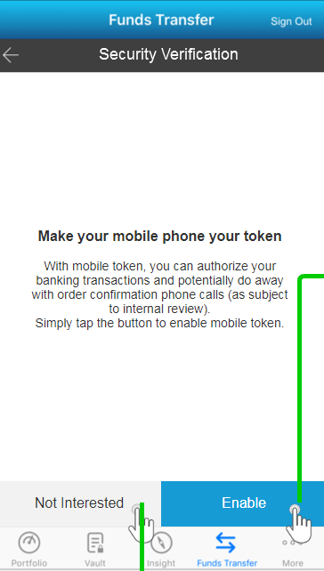
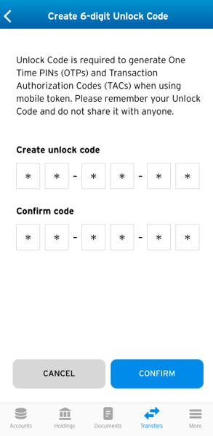
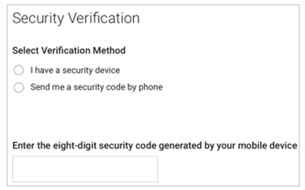
Non-mobile token enabled user performing low-value funds transfer on mobile
3
4
2
1

Slide 7
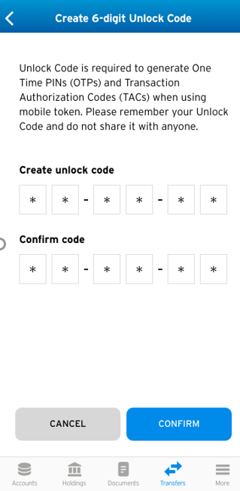
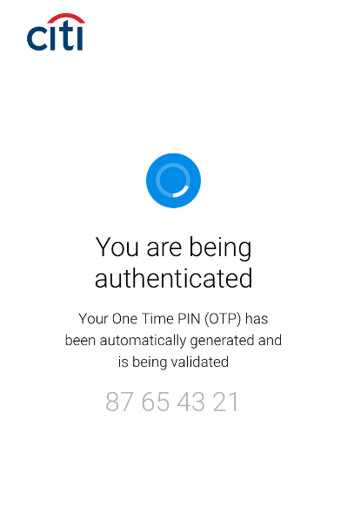
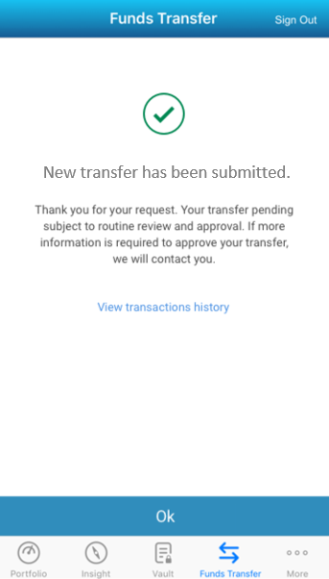
Non-mobile token enabled user performing low-value funds transfer on mobile
4

Slide 8
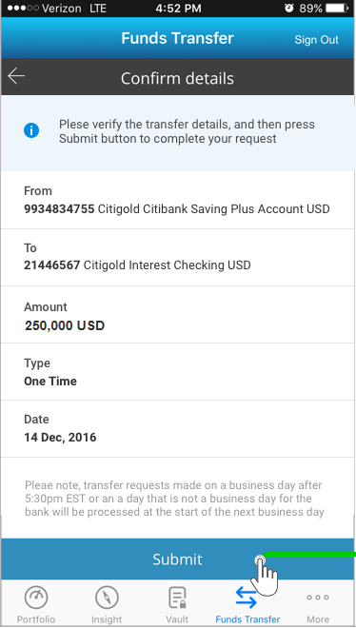
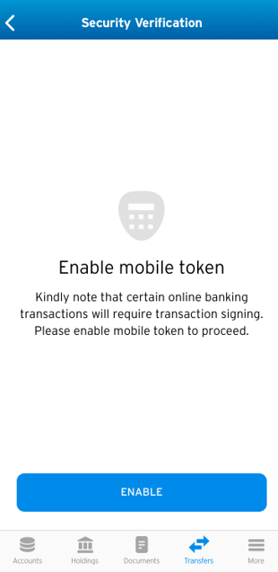
Non-mobile token enabled user performing high-value funds transfer or add payee on mobile
3
2
4
1

Slide 9
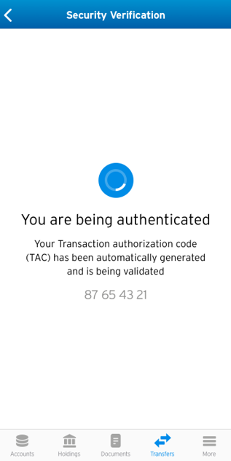
Non-mobile token enabled user performing high-value funds transfer or add payee on mobile
4

Slide 10
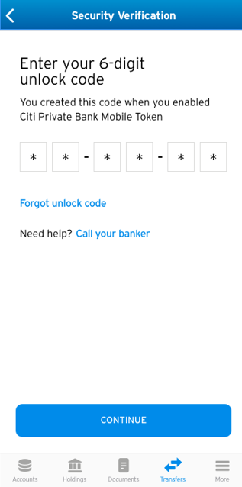
Mobile token enabled user performing low-value funds transfer on the same mobile device
2
3
1

Slide 11
Mobile token enabled user performing high-value funds transfer on the same mobile device
2
3
1

Slide 12
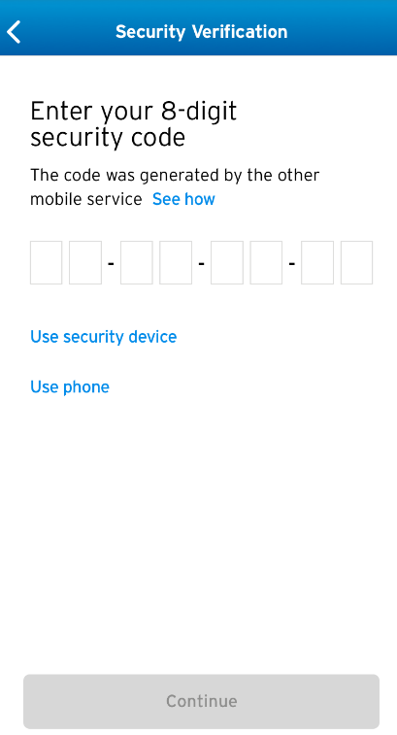

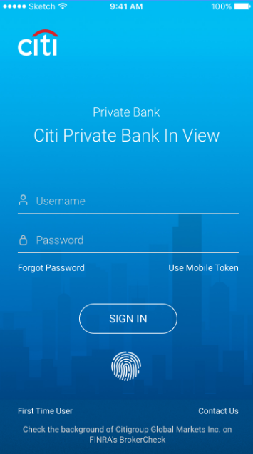
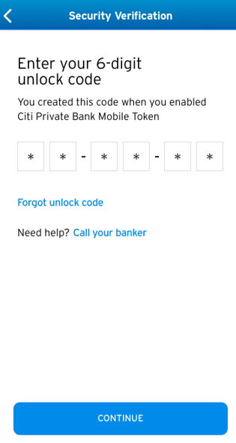
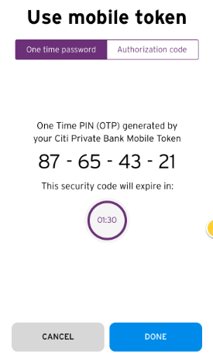
Mobile token enabled user performing low-value funds transfer on a different mobile device
DEVICE
A
5
1
6
DEVICE B (Mobile Token Enabled)
3
2
4

Slide 13
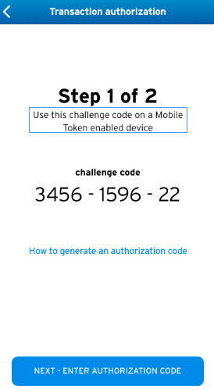
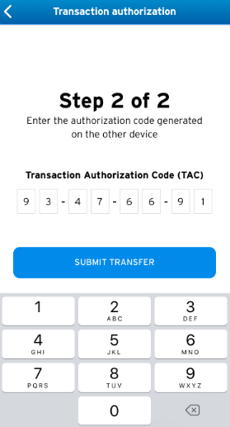
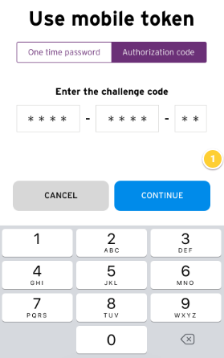
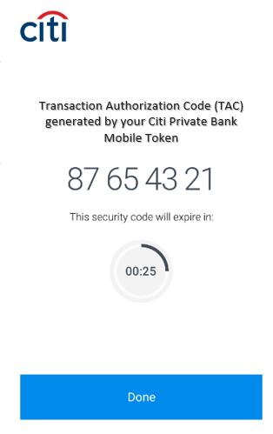
Mobile token enabled user performing high-value funds transfer or add payee funds transfer on a different mobile device
DEVICE
A
7
8
1
5
DEVICE B (Mobile Token Enabled)
3
6
2
4

Slide 14
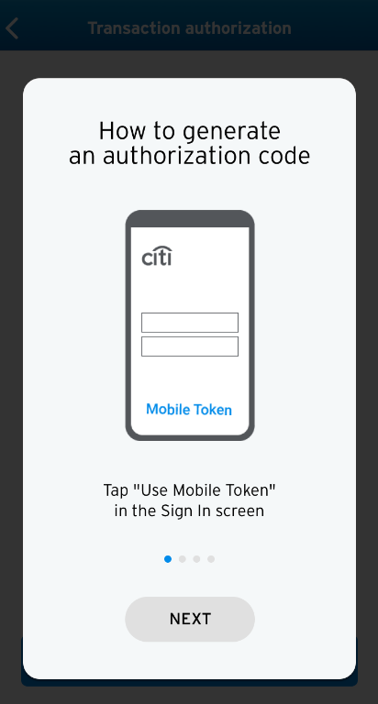
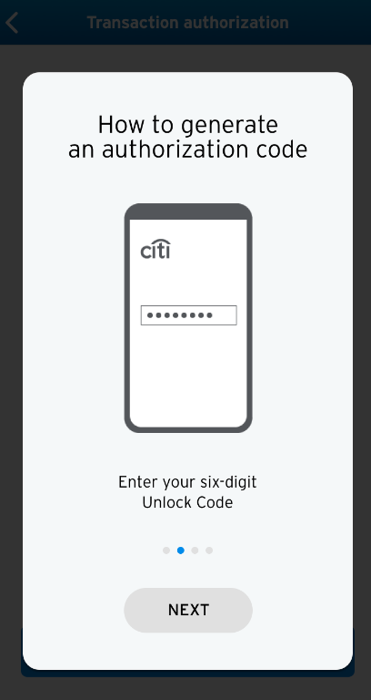
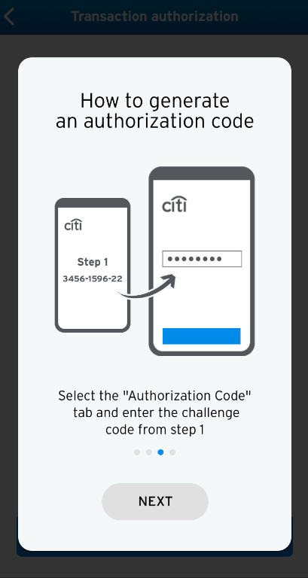
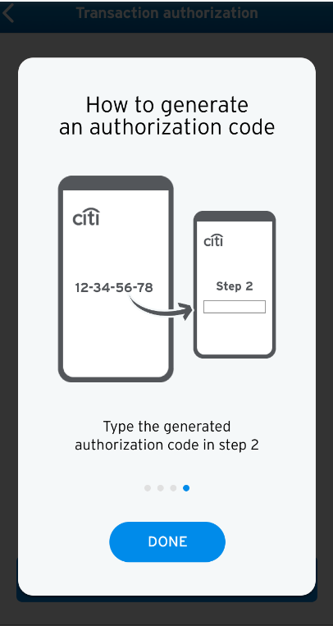
Mobile token enabled user performing high-value funds transfer or add payee funds transfer on a different mobile device

Slide 15
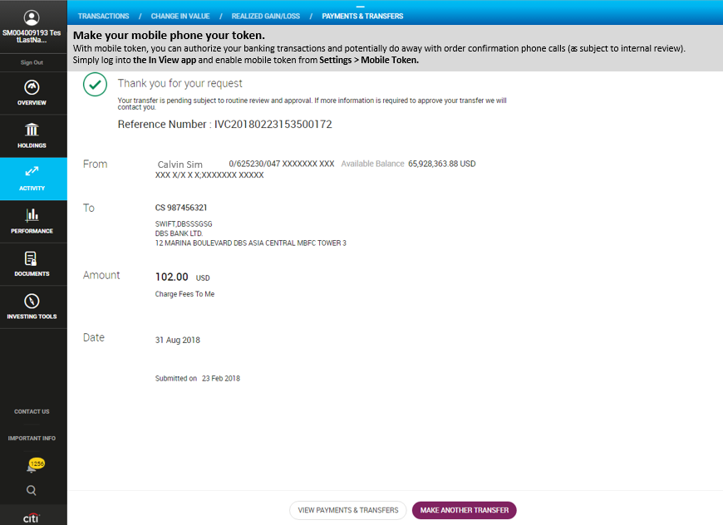
Non-mobile token enabled user using FT on web

Slide 16
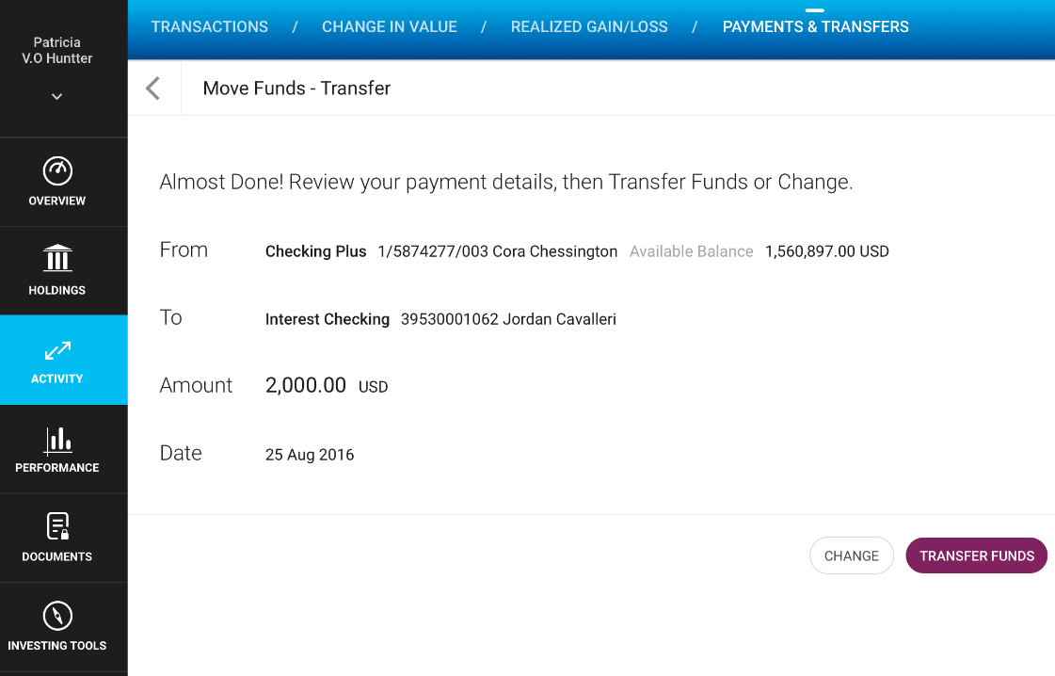
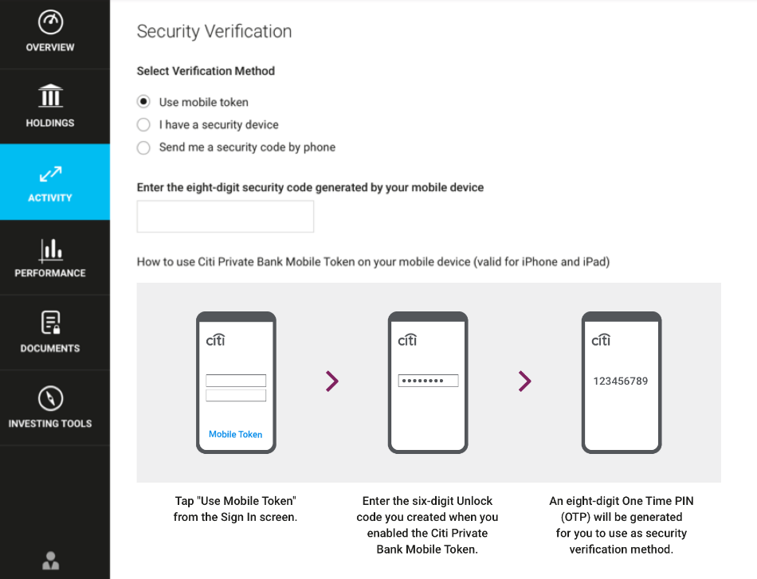

Mobile token enabled user performing low-value funds transfer on web
5
1
3
Mobile Token Enabled Device
2
4

Slide 17
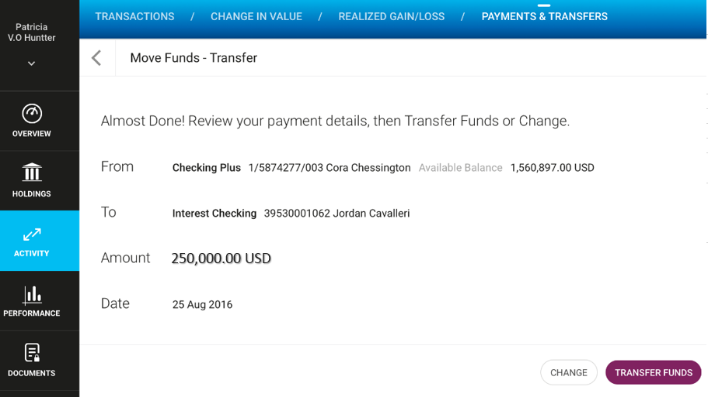
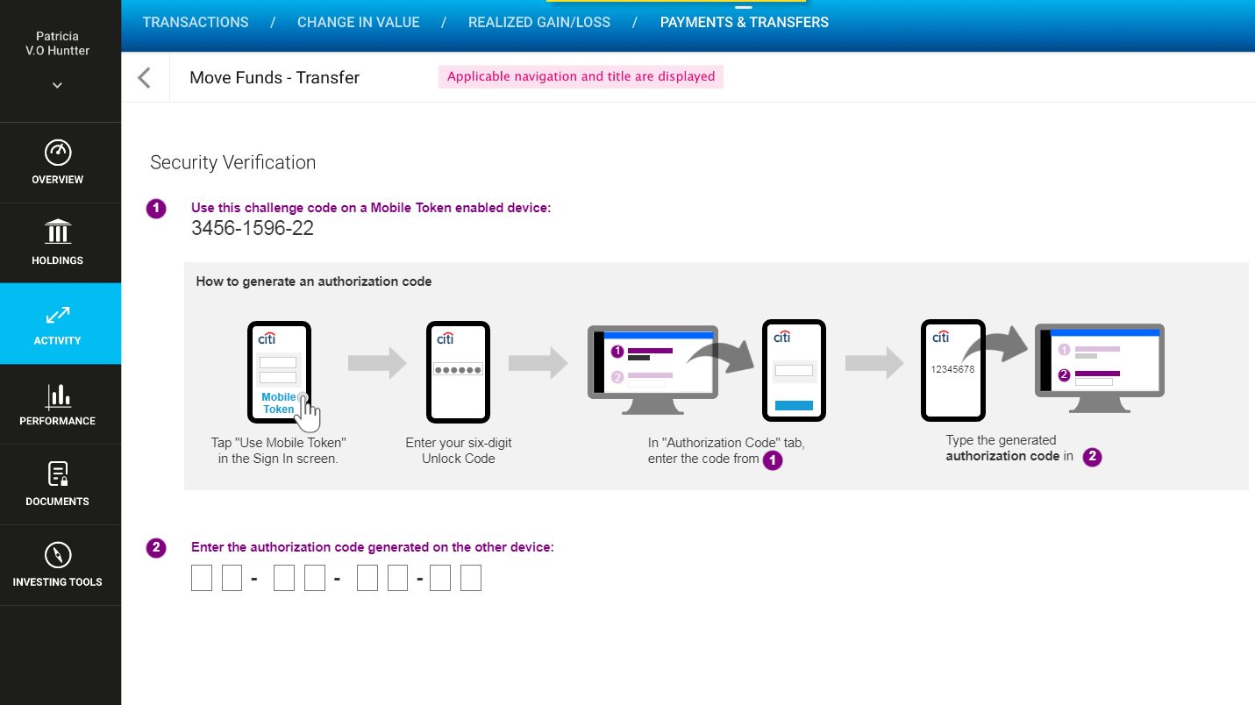

Mobile token enabled user performing high-value funds transfer or add payee on web
7
5
Mobile Token Enabled Device
3
2
6
4

Slide 18
Challenge Code Logic
The TAC challenge code is generated based on the transaction data (logic explained below), and the transaction is signed on this TAC that is generated based on the Challenge Code. All the transaction that is done via Citi Private Bank is all end to end encrypted and even if a different account number is added by an attacker via man-in-the middle type attacks it will fail during the verification process, because the signature on the TAC signed by the customer will not match the TAC on the server side which is created with the modified account number.
Challenge Code Generation during Payee Addition
Components of the Add Payee Challenge code = XXXXYYZZZZ (Length of 10 digits)
XXXX – Last 4 digits of Destination Account Number. If last 4 digits are Non Numeric then, first 4 digits of equivalent HASH value is considered.
YY – First 2 digits of Hashed (Hashed (Member ID + Account Number)/Current Time) – This is the dynamic variable which is tied to the individual transaction that the customer is trying to perform and this gets embedded as part of the Challenge Code.
ZZZZ – 4 Digit Random number to fill the default length of Challenge code
Challenge Code Generation during For Payments above 200,000 USD:
Components of the transaction Challenge code = XXXXYYZZAA (Length of 10 digits)
XXXX – Last 4 digits of Destination Account Number. If last 4 digits are Non Numeric then, first 4 digits of equivalent HASH value is considered.
YY – First 2 digits Transaction Amount. For transaction signing amount will always be >200000, so no single digit issue here.
ZZ - First 2 digits of Hashed (Hashed (Member ID + Account Number + Transaction Amount)/Current Time) - This is the dynamic variable which is tied to the individual transaction that the customer is trying to perform and this gets embedded as part of the Challenge Code
AA – 2 Digit Random number to fill the default length of Challenge code

Slide 19
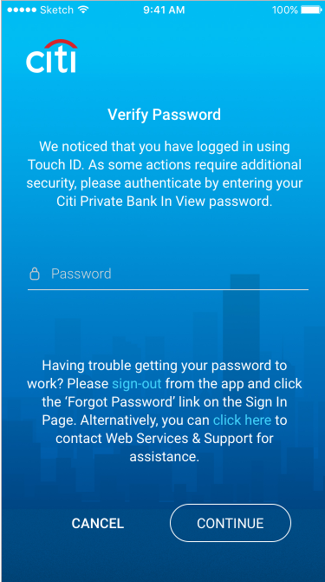
Touch ID
For High Risk Fund Transfer functions, CPB InView Web password re-entry will be required to complete the transaction.
Add Payee
FT External >200K USD or FT Internal >200K USD
For Low Risk Fund Transfer functions, the password re-entry will not be required and Client can execute the transaction after login using Touch ID .

Slide 20
Fund Transfer Limits – APAC/EMEA/US
Funds Transfer | APAC | EMEA | US
Transaction Limits (Internal Transfers) | Unlimited | Unlimited | Unlimited
Transaction Limits (External Transfers) | 1. Same Currency – USD 10 MM per transfer (up to USD1mm per day). 2. FX – Below USD 50K per transfer (up to USD 10MM per day). | Same currency – 10 mm (daily/one time) FX – 200k (daily/one time) | USD – 1 mm (daily/one time) FX – 200k (daily/one time)
Call back Requirements | 1. As per signing mandate. 2. First Time Payees 3. Third-Party Transfers (Internal and External) > USD 200K | As per signing mandate First Time Payee External Transfer > 200K | As per signing mandate (best effort basis) First Time Payee External Transfer > 200K

